Slide 1


Social Buzz Analysis

Slide 2


Today's agenda
Project recap
Problem
The Analytics team
Process
Insights
Summary

Slide 3

yuguygihuijkkkkkkkkkkkkkkkkkkkkkllllllllllllll
Social Buzz is a social media platform who wants to adapt properly to its rapidly growing platform currently reaching 500 million active users monthly. Here are the tasks Accenture will focus on:
Audit of big data practices
Recommendations for successful IPO
Analysis of Social Buzz’s top 5 most popular categories
Project Recap

Slide 4


Problem
With over 100,000 posts every day that makes about 3,000,000 posts a month.
To determine the best course of action, lets find the popular categories of content.

Slide 5






Chief Technology Architect:
Andrew Fleming
The Analytics team
Senior Principle:
Marcus Rompton
Data Analyst:
Andres Almaraz

Slide 6
Examining and understanding the data model
Process
1
2
Collecting the required data
3
Cleaning the datasets
4
Merging datasets
5
Analyzing the Data

Slide 7

Insights
Travel
Photo
11:00 PM
Most Popular Content Type
Most Popular Category
Hour With Most Posts
Notes:
6:00 AM followed second with most posts behind by only 1.

Slide 8
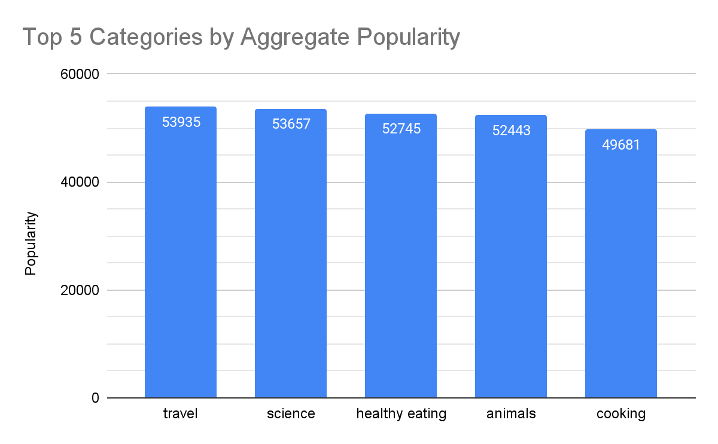
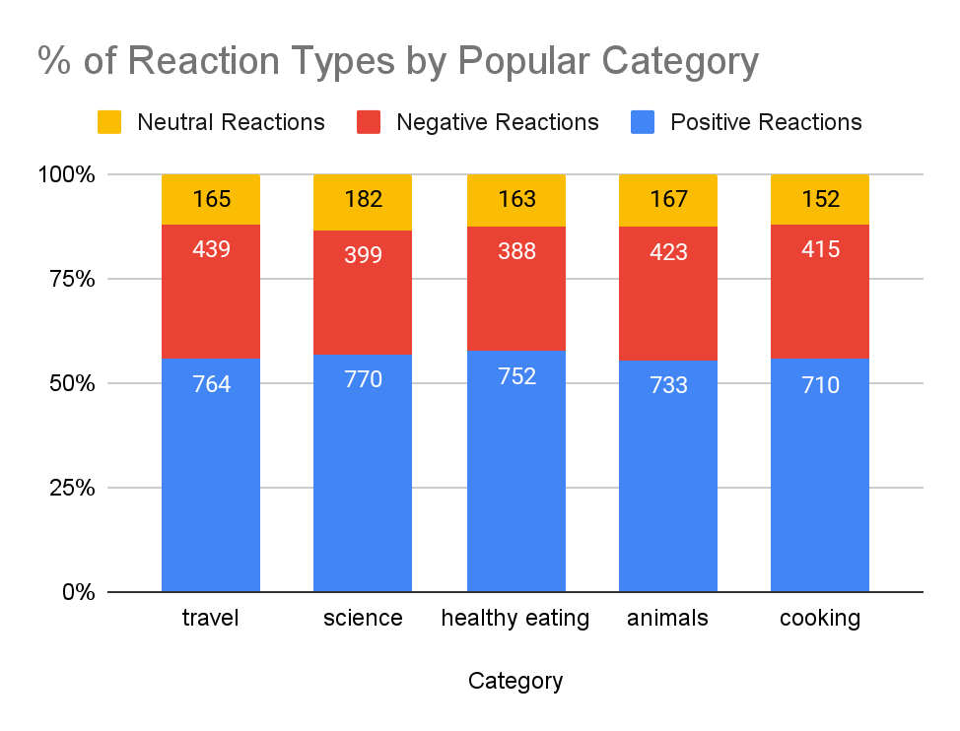
Popular Categories
Notes:
Top 5 categories all nearly reach or exceed 50,000 in popularity score. Travel being the highest at 53,935 in popularity score
Popular categories perform almost similar in reaction types. However, healthy eating and science is higher in positive reactions by 1-2%. Also have lowest % of negative reaction by 3%

Slide 9
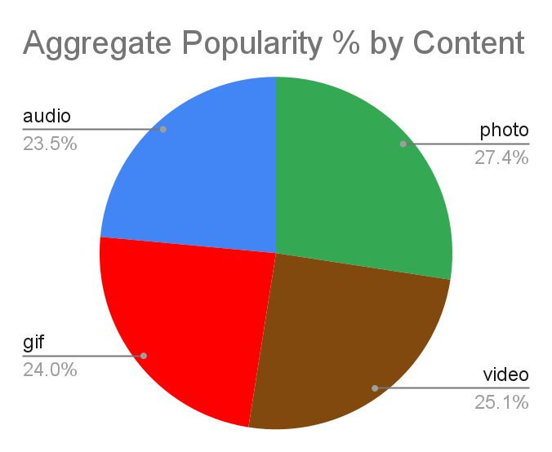
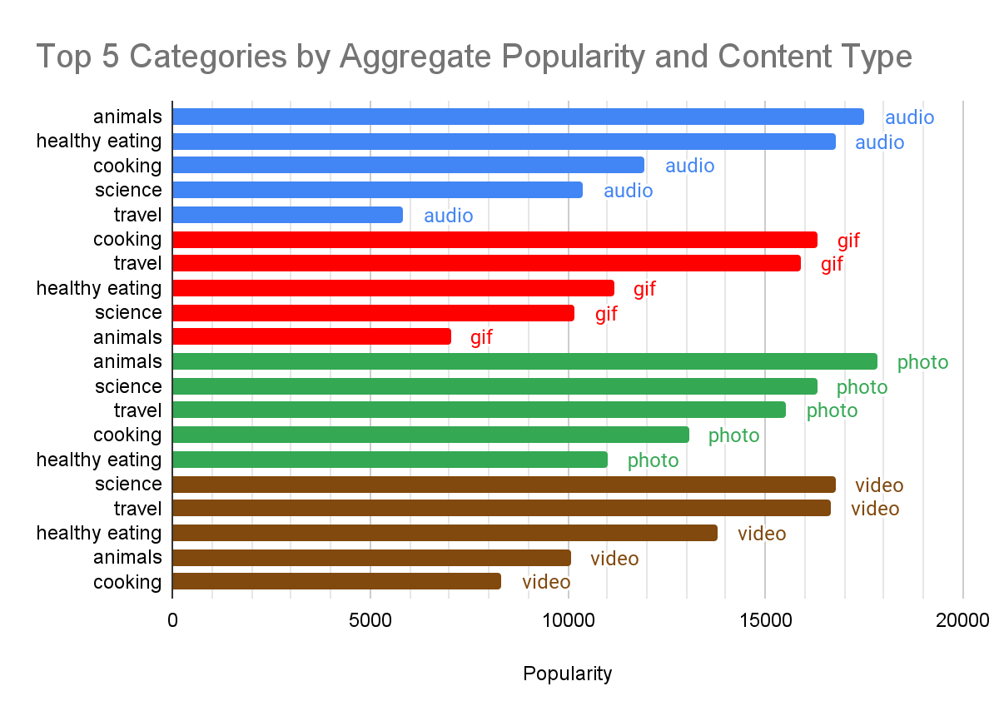
Content Type and Categories
Notes:
Photo is highest in popularity

Slide 10

Analysis
Travel is the most popular category and is 2nd in photos and videos. This implies people want to enjoy the feel of experiencing new location or exploring.
Insights
With travel being the top category, it might be beneficial to look into working with traveling agencies. It is also worth noting since cooking and healthy eating are quite similar, it is a good idea to market towards that audience through audio or gifs with recipes or products. Finally, for more user engagement in the animal category, a push towards audio and photos can help to boost that.
Summary

Slide 11

Thank you!
ANY QUESTIONS?

